Slide 1
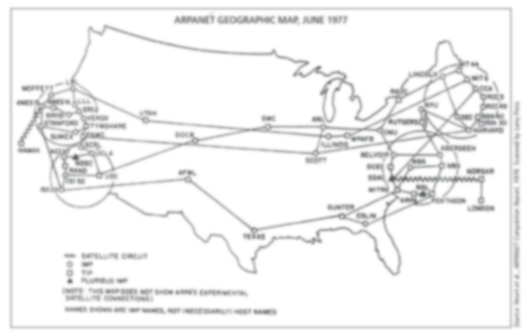
The Beginning: A "Network of Networks"

Slide 2

The seeds of the Internet were planted in - 1969 - ADVANCED RESEARCH PROJECT AGENCY – ARPA (U.S. Department of Defense) - began connecting computers - at different universities and defense contractors - ARPANET

Slide 3
The goal of this early project was
to create a large computer network
with multiple paths
in the form of telephone lines
that could survive a nuclear attack or a natural disaster such as an earthquake.

Slide 4
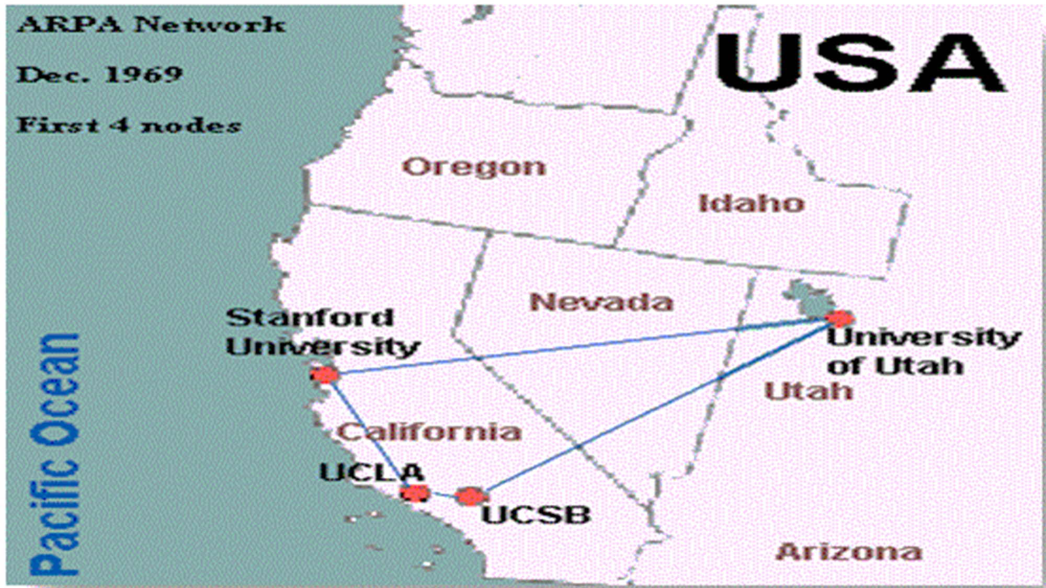
At first, ARPANET was basically a - large network - serving only a handful of users, - but it expanded rapidly. - jumped across the Atlantic to Europe -in 1973, - and it never stopped growing.

Slide 5

After the Defense Department stopped funding the network in the mid-1980s,
another federal agency
the NATIONAL SCIENCE FOUNDATION - NSF
joined the project.

Slide 6
NSF
established five “supercomputing centers”
that were available to anyone who wanted to use them
for academic research purposes.
quickly discovered
the existing network
could not handle the load.
created a
new, higher-capacity network,
called NSFnet
The link between ARPANET, NSFnet, and other networks
was called the Internet

Slide 7
The NSF did not permit private business
therefore, several private telecommunications companies built their own network
these private portions of the Internet
were not limited by NSFnet as "appropriate use" restrictions,
so it became possible to use the Internet
to distribute business and commercial information.
The original ARPANET was shut down in 1990,
and government funding for NSFnet was discontinued in 1995,
but the commercial Internet backbone services replaced them
by the early 1990s, interest in the Internet began to expand dramatically

Slide 8
The system that had been created as a tool for surviving a nuclear war found its way into businesses and homes. Now, advertisements for movies are far more common online than collaborations on physics research.

Slide 9


Slide 10
Today: Still Growing
Today, the Internet connects thousands of networks and hundreds of millions of users around the world.

Slide 11
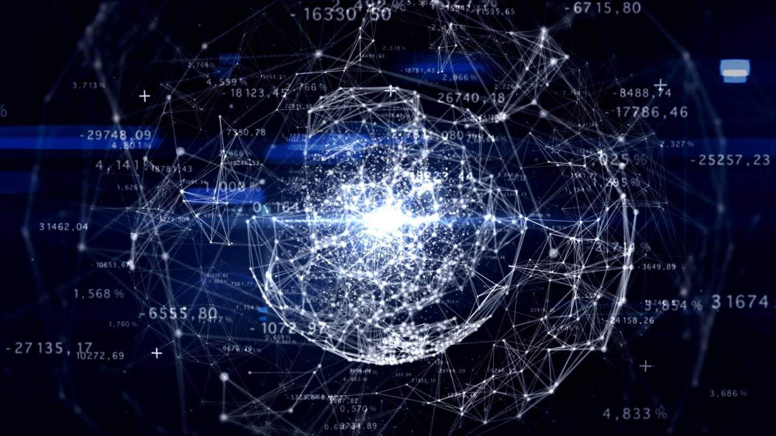

Slide 12
It is a
huge, cooperative community
with no central ownership.
This lack of ownership is an important feature of the Internet, because it means that no single person or group controls the network.

Slide 13
The Internet is open to anyone who can access it.
If you can use a computer
and if the computer is connected to the Internet,
you are free not only to use the resources posted by others, but to create resources of your own
This openness has attracted millions of users to the Internet. Internet access was available to nearly one- half billion people worldwide in 2001. The number of actual users continues to climb dramatically.

Slide 14
